Slide 1
PHYS 304: Lecture 9 (Intro to) Quantum Mechanics
Sept-Dec 2021 Edition
Jeff Young
brimacombe Rm 278, young@phas.ubc.ca

Slide 2
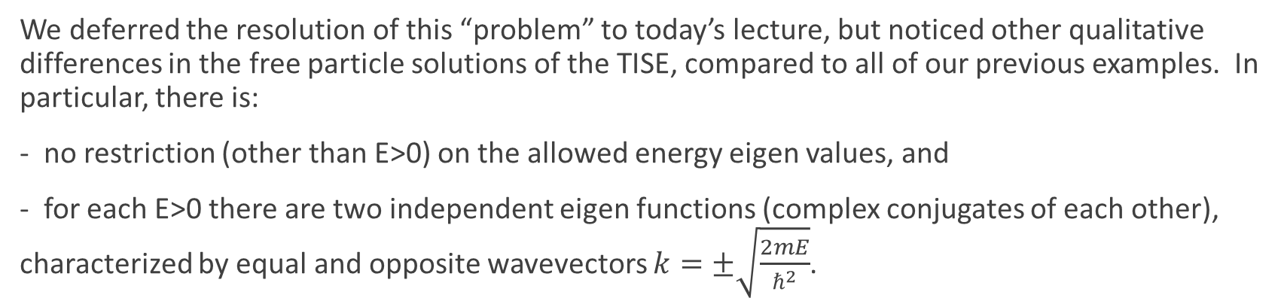
Review of Key points from last day
Stationary states don’t exist for free electrons (V=0 in all space), because purely harmonic wavefunctions can’t be normalized (the wavefunctions don’t decay to zero at plus and minus infinity).
We deferred the resolution of this “problem” to today’s lecture, but noticed other qualitative differences in the free particle solutions of the TISE, compared to all of our previous examples. In particular, there is:
- no restriction (other than E>0) on the allowed energy eigen values, and
- for each E>0 there are two independent eigen functions (complex conjugates of each other), characterized by equal and opposite wavevectors $k=±\sqrt{\frac{2mE}{ℏ^{2}}}$.

Slide 3
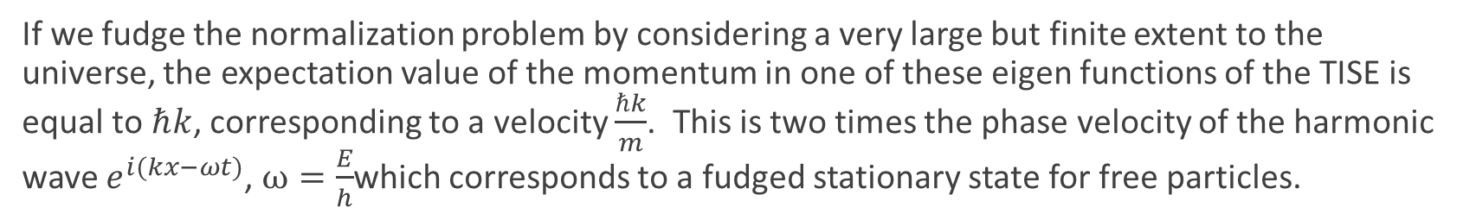
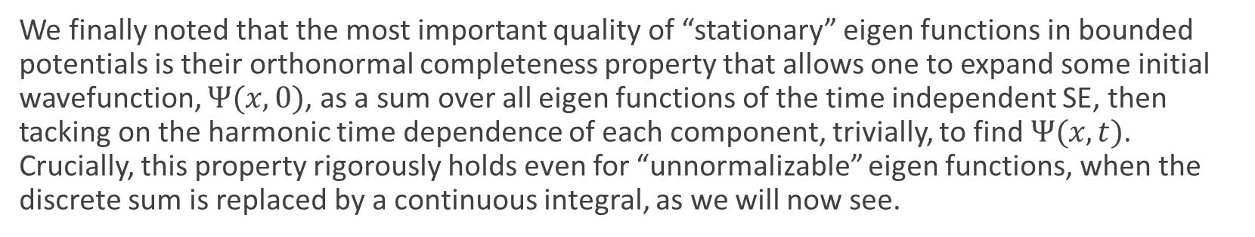
Review of Key points from last day
If we fudge the normalization problem by considering a very large but finite extent to the universe, the expectation value of the momentum in one of these eigen functions of the TISE is equal to $ℏk$, corresponding to a velocity $\frac{ℏk}{m}$. This is two times the phase velocity of the harmonic wave $e^{i(kx−ωt)}$, $ω=\frac{E}{h}$which corresponds to a fudged stationary state for free particles.
We finally noted that the most important quality of “stationary” eigen functions in bounded potentials is their orthonormal completeness property that allows one to expand some initial wavefunction, $Ψ(x,0)$, as a sum over all eigen functions of the time independent SE, then tacking on the harmonic time dependence of each component, trivially, to find $Ψ(x,t)$. Crucially, this property rigorously holds even for “unnormalizable” eigen functions, when the discrete sum is replaced by a continuous integral, as we will now see.

Slide 4
Today
Gaussian Wavepackets, group velocity, particle localization. (notes on board from pre-reading)

Slide 5
Before starting
Midterm Oct 21 during class.
60 minutes in duration. Closed book, but we provide an equation sheet that will be published before the exam. No homework due next week.
See posted versions of previous years’ midterms.
Will cover everything we have done in lectures, tutorials, and problem sets, up to and including the free electron (end of today’s lecture).
Arnab has already posted last year’s Tutorial that provided a review before the midterm. See Piazza:
Title: PHYS 304 101 2020W Introduction to Quantum Mechanics (Tutorial)
https://ubc.zoom.us/rec/play/3_UcZ5hCAYd-dTgMvNxe78gtik2LFlgXPVQ7Jk2S2FiLZXT5bRjMcH6oPwdASwTM_X7d3nk_NKtyhJCo.Mts2cbqzApIPvjVn
Passcode: 7&=VLeSq
Note: Section 2.6 of the text lays out how to solve Problem 3 in this week’s homework. Electron incident from left.
Go to Piazza and sign up for preferred Office Hours with David

Slide 6
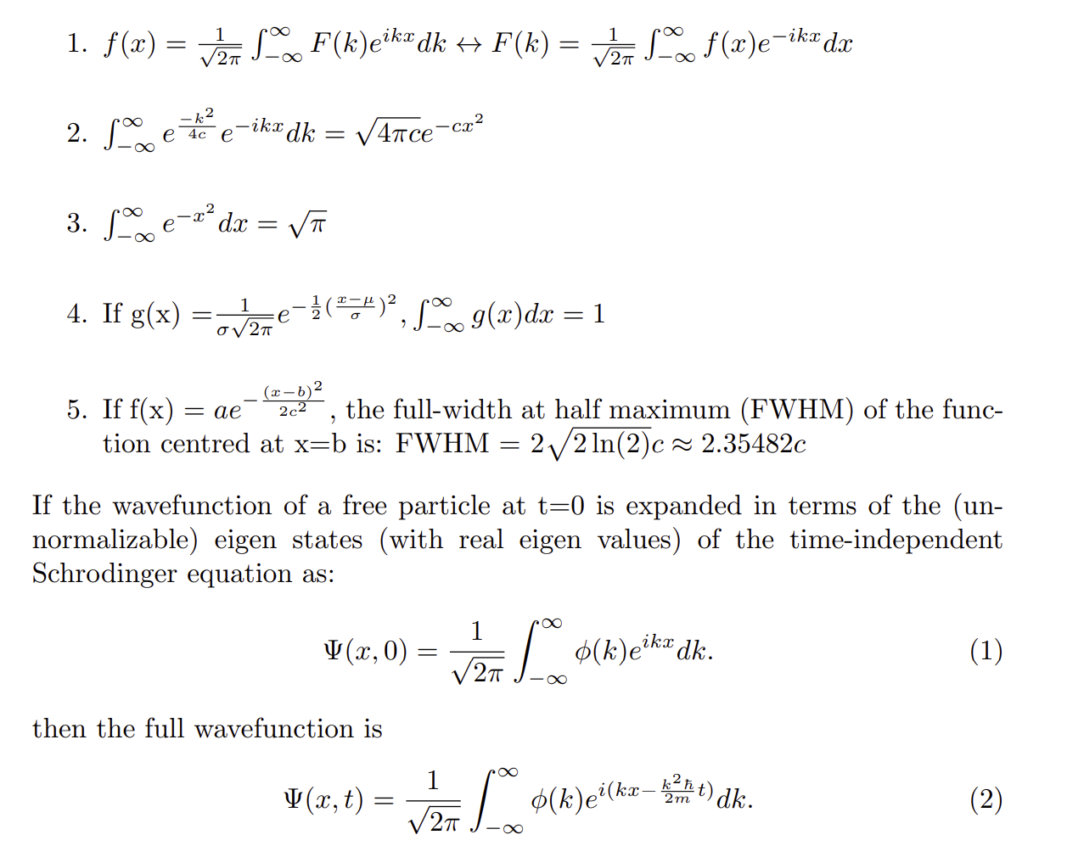
Useful Equations

Slide 7
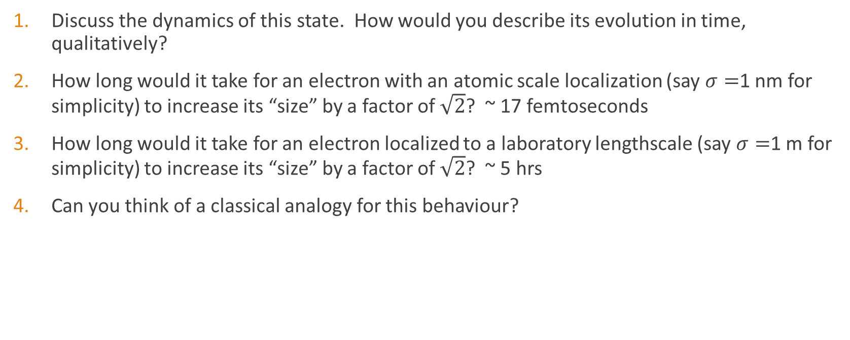
Lecture 9, Activity 1: (Discussion)
Discuss the dynamics of this state. How would you describe its evolution in time, qualitatively?
How long would it take for an electron with an atomic scale localization (say $σ=$1 nm for simplicity) to increase its “size” by a factor of $\sqrt{2}$? ~ 17 femtoseconds
How long would it take for an electron localized to a laboratory lengthscale (say $σ=$1 m for simplicity) to increase its “size” by a factor of $\sqrt{2}$? ~ 5 hrs
Can you think of a classical analogy for this behaviour?

Slide 8
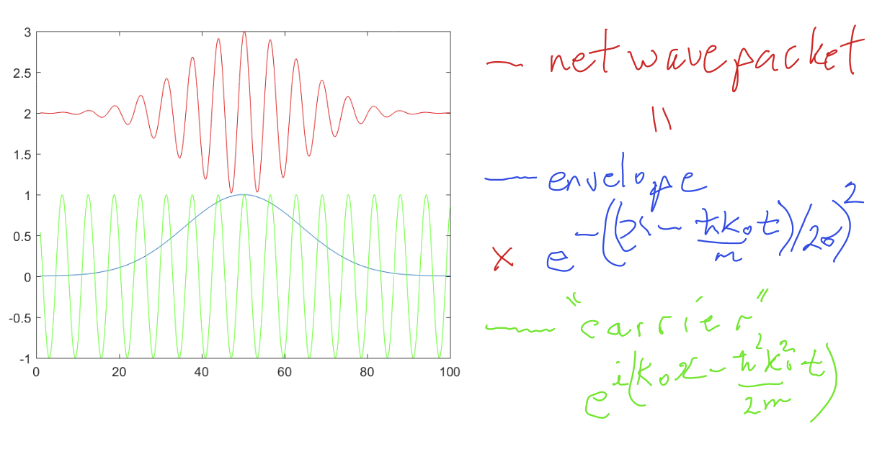
Impart a velocity to the wavepacket
(notes on board from pre-reading)

